Slide 1
Chapter Three Greedy Method
Among all the algorithmic approaches, the simplest and straightforward approach is the Greedy method.
In this approach, the decision is taken on the basis of current available information without worrying about the effect of the current decision in future.
Greedy algorithms build a solution part by part, choosing the next part in such a way, that it gives an immediate benefit.
This approach never reconsiders the choices taken previously. This approach is mainly used to solve optimization problems.
Greedy method is easy to implement and quite efficient in most of the cases. Hence, we can say that Greedy algorithm is an algorithmic paradigm based on heuristic that follows local optimal choice at each step with the hope of finding global optimal solution.
In many problems, it does not produce an optimal solution though it gives an approximate(near optimal) solution in a reasonable time.

Slide 2
Components of Greedy Algorithm
Greedy algorithms have the following five components:
A candidate set: A solution is created from this set.
A selection function: Used to choose the best candidate to be added to the solution.
A feasibility function: Used to determine whether a candidate can be used to contribute to the solution.
An objective function: Used to assign a value to a solution or a partial solution.
A solution function: Used to indicate whether a complete solution has been reached.

Slide 3
Application of Greedy Method
Greedy approach is used to solve many problems, such as
Job sequencing with deadline
Finding the shortest path between two vertices using Dijkstra’s algorithm.
Finding the minimal spanning tree in a graph using Prim’s /Kruskal’s algorithm
Huffman Code
Where Greedy Approach Fails
In many problems, Greedy algorithm fails to find an optimal solution, moreover it may produce a worst solution. Problems like Travelling Salesman and Knapsack cannot be solved using this approach.

Slide 4
Job Sequencing with Deadline
Problem Statement
You are given a set of N jobs where each job comes with a deadline and profit. The profit can only be earned upon completing the job within its deadline. Find the number of jobs done and the maximum profit that can be obtained. Each job takes a single unit of time and only one job can be performed at a time.
Solution
Let us consider, a set of n given jobs which are associated with deadlines and profit is earned, if a job is completed by its deadline. These jobs need to be ordered in such a way that there is maximum profit.
It may happen that all of the given jobs may not be completed within their deadlines.
Assume, deadline of ith job Ji is di and the profit received from this job is pi. Hence, the optimal solution of this algorithm is a feasible solution with maximum profit. Thus, 𝑫(𝒊) > 𝟎 for 𝟏 ≤ 𝒊 ≤ 𝒏.
Initially, these jobs are ordered according to profit, i.e. 𝒑𝟏 ≥ 𝒑𝟐 ≥ 𝒑𝟑 ≥ … ≥ 𝒑𝒏.

Slide 5
Basic Outline of the approach
Approach: The strategy to maximize profit should be to pick up jobs that offer higher profits. Hence we should sort the jobs in descending order of profit. Now say if a job has a deadline of 4 we can perform it anytime between day 1-4, but it is preferable to perform the job on its last day. This leaves enough empty slots on the previous days to perform other jobs.
Basic Outline of the approach:-
Sort the jobs in descending order of profit.
If the maximum deadline is x, make an array of size x .Each array index is set to -1 initially as no jobs have been performed yet.
For every job check if it can be performed on its last day.
If possible mark that index with the job id and add the profit to our answer.
If not possible, loop through the previous indexes until an empty slot is found.

Slide 6
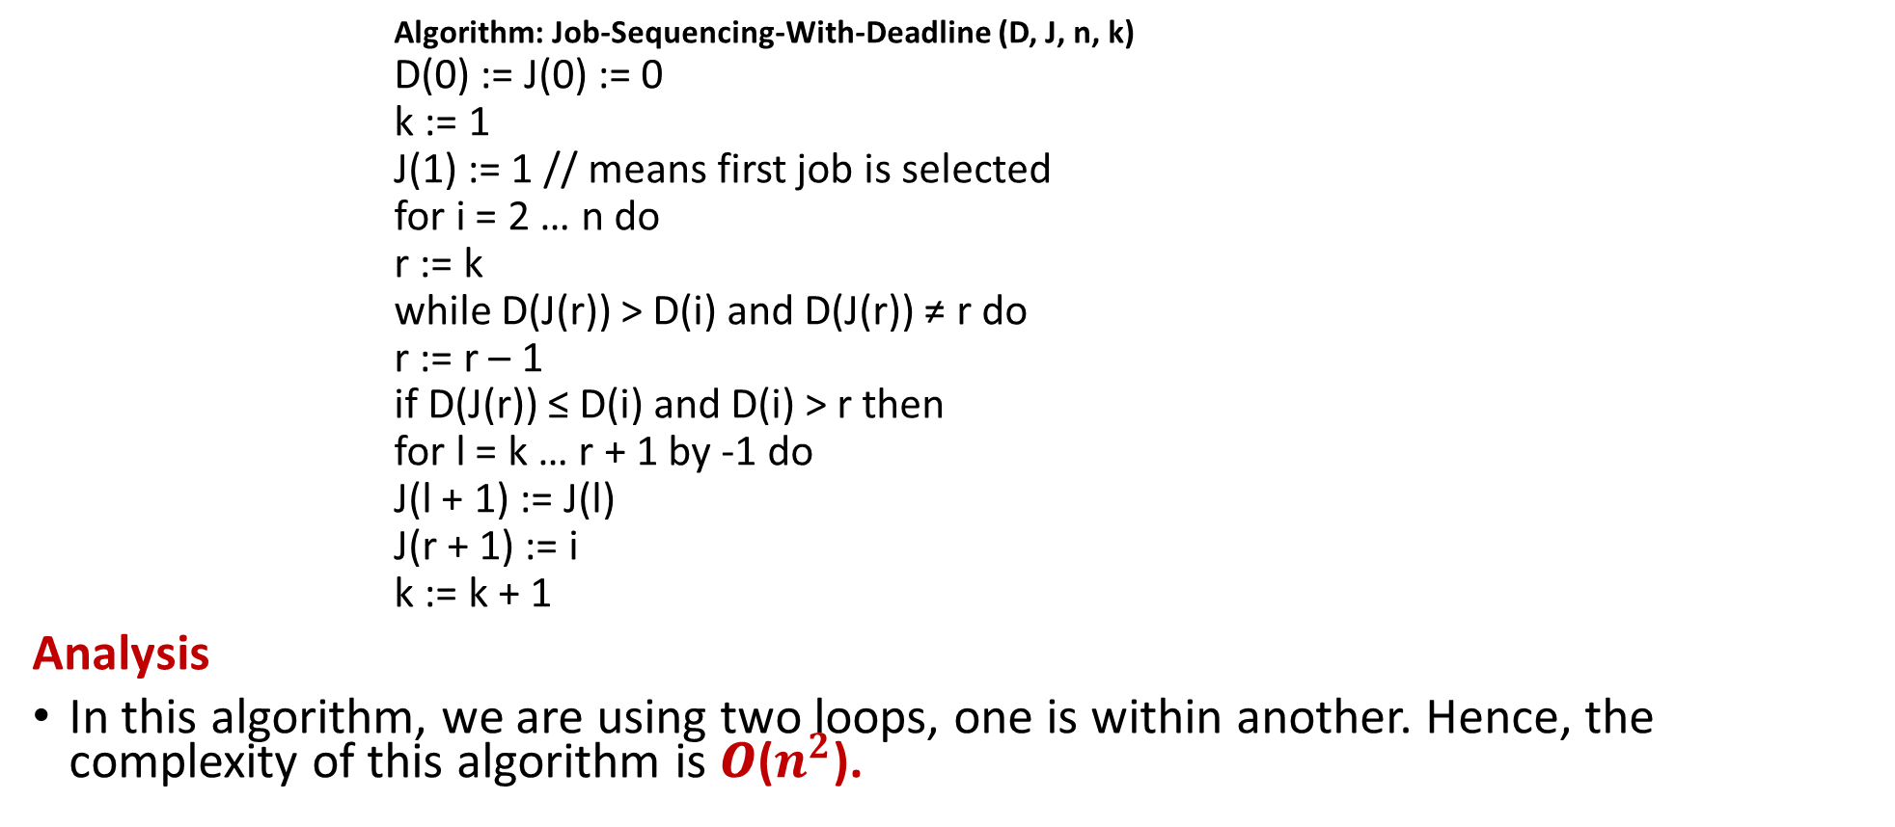
Algorithm: Job-Sequencing-With-Deadline
Algorithm: Job-Sequencing-With-Deadline (D, J, n, k)
D(0) := J(0) := 0
k := 1
J(1) := 1 // means first job is selected
for i = 2 … n do
r := k
while D(J(r)) > D(i) and D(J(r)) ≠ r do
r := r – 1
if D(J(r)) ≤ D(i) and D(i) > r then
for l = k … r + 1 by -1 do
J(l + 1) := J(l)
J(r + 1) := i
k := k + 1
Analysis
In this algorithm, we are using two loops, one is within another. Hence, the complexity of this algorithm is 𝑶($n^{2}$).

Slide 7
Example
Let us consider a set of given jobs as shown in the following table. We have to find a sequence of jobs, which will be completed within their deadlines and will give maximum profit. Each job is associated with a deadline and profit.
Solution
To solve this problem, the given jobs are sorted according to their profit in a descending
order. Hence, after sorting, the jobs are ordered as shown in the following table.

Slide 8
Cont.…
From this set of jobs, first we select J2, as it can be completed within its deadline and contributes maximum profit.
Next, J1 is selected as it gives more profit compared to J4.
In the next clock, J4 cannot be selected as its deadline is over, hence J3 is selected as it executes within its deadline.
The job J5 is discarded as it cannot be executed within its deadline.
Thus, the solution is the sequence of jobs (J2, J1, J3), which are being executed within their deadline and gives maximum profit.
Total profit of this sequence is 𝟏𝟎𝟎 + 𝟔𝟎 + 𝟐𝟎 = 𝟏𝟖𝟎.

Slide 9
Dijkstra’s algorithm
Dijkstra's algorithm - is a solution to the single-source shortest path problem in graph theory.
Works on both directed and undirected graphs. However, all edges must have nonnegative weights.
Approach: Greedy
Input: Weighted graph G={E,V} and source vertex v∈V, such that all edge weights are nonnegative
Output: Lengths of shortest paths (or the shortest paths themselves) from a given source vertex v∈V to all other vertices

Slide 10
Dijkstra's algorithm - Pseudocode
dist[s] ←0 (distance to source vertex is zero) for all v ∈ V–{s} do dist[v] ←∞ (set all other distances to infinity) S←∅ (S, the set of visited vertices is initially empty) Q←V (Q, the queue initially contains all vertices) while Q ≠∅ (while the queue is not empty) do u ← mindistance(Q,dist) (select the element of Q with the min. distance) S←S∪{u} (add u to list of visited vertices) for all v ∈ neighbors[u] do if dist[v] > dist[u] + w(u, v) (if new shortest path found) then d[v] ←d[u] + w(u, v) (set new value of shortest path)
(if desired, add traceback code)
return dist

Slide 11
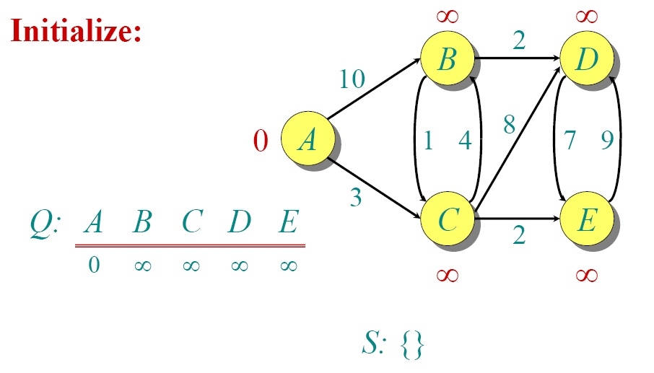
Dijkstra Example

Slide 12
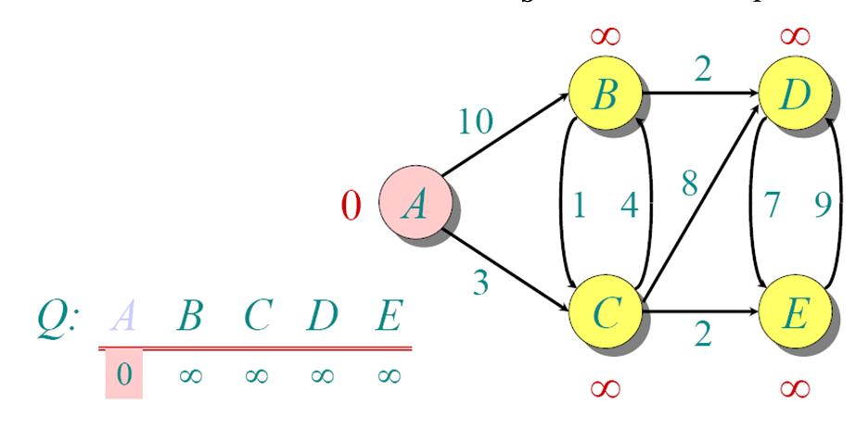
Dijkstra Example

Slide 13
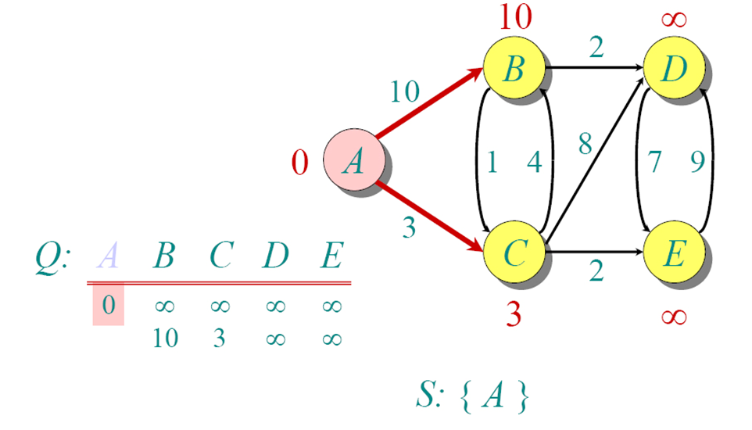
Dijkstra Example

Slide 14
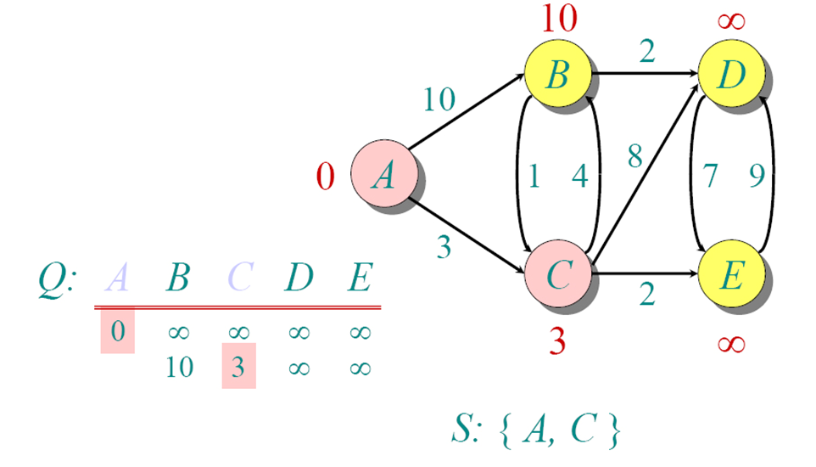
Dijkstra Example

Slide 15
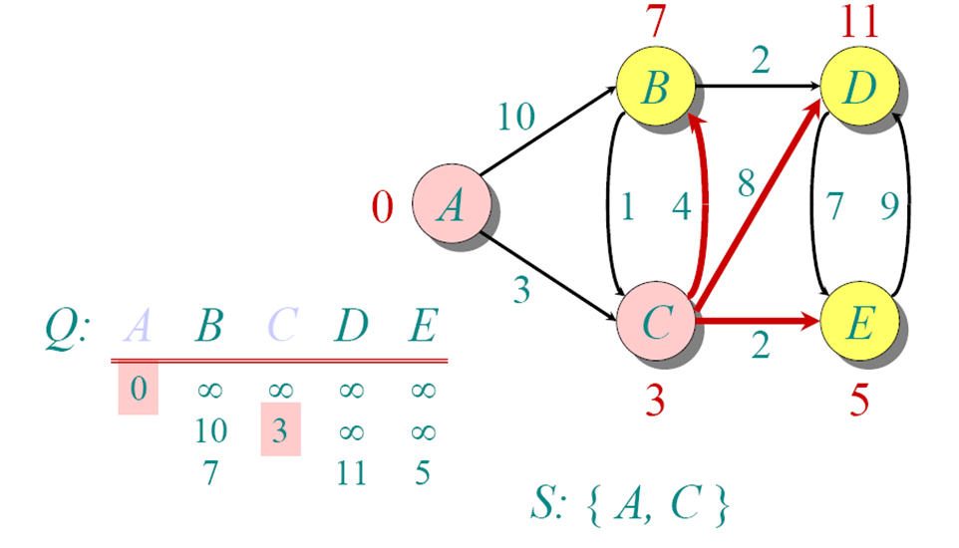
Dijkstra Example

Slide 16
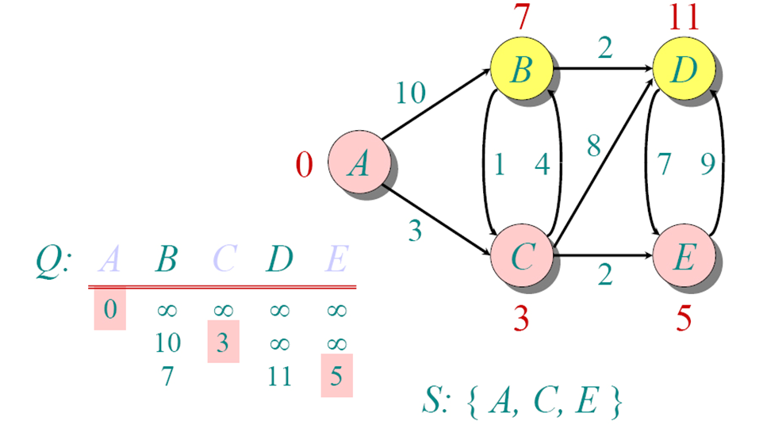
Dijkstra Example

Slide 17
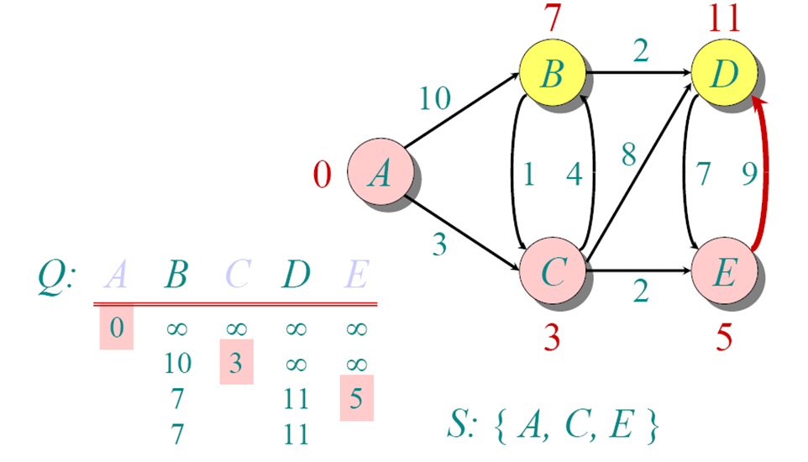
Dijkstra Example

Slide 18
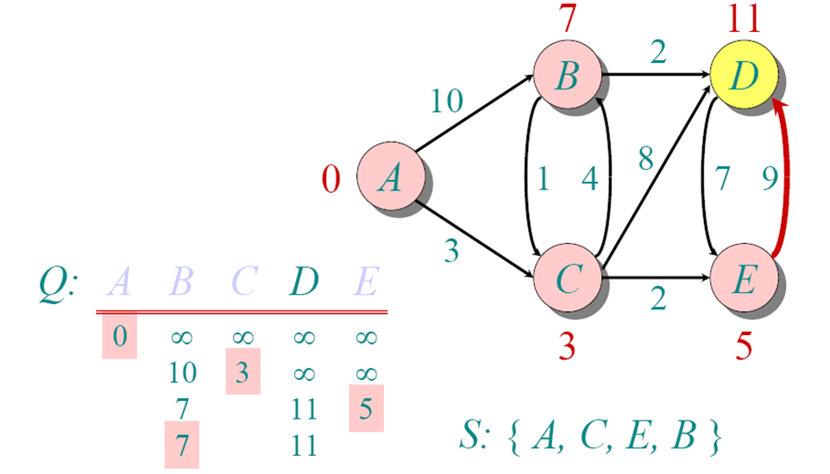
Dijkstra Example

Slide 19
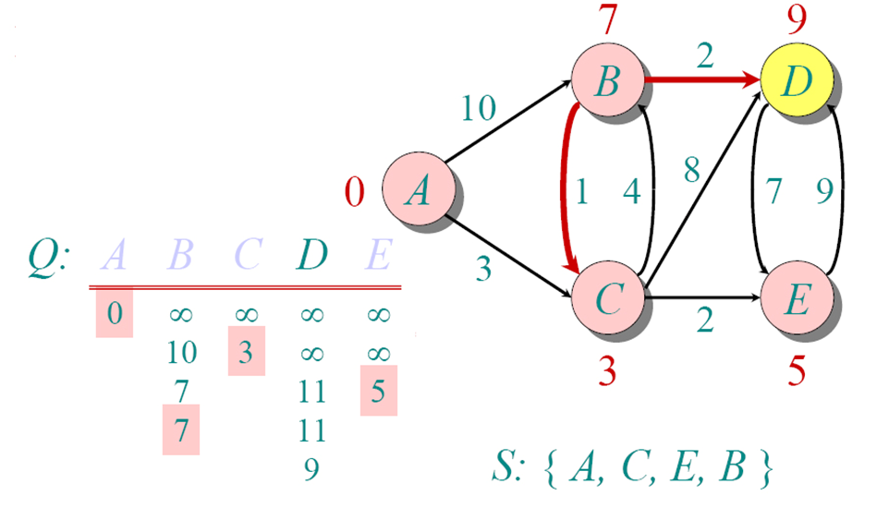
Dijkstra Example

Slide 20
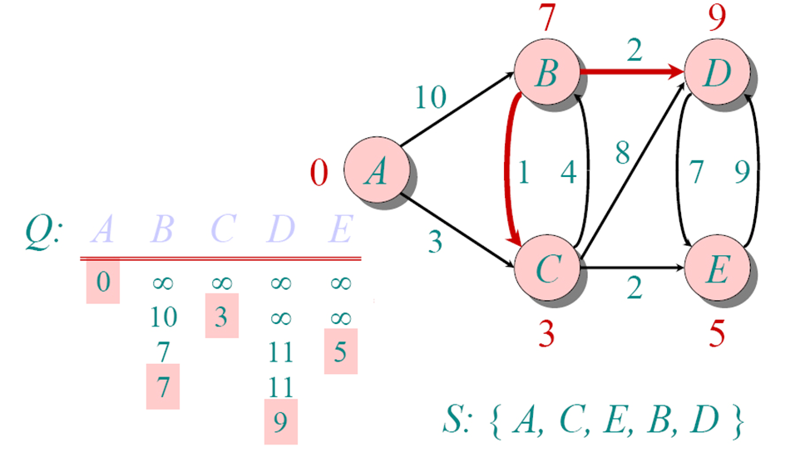
Dijkstra Example

Slide 21
Implementations and Running Times
The simplest implementation is to store vertices in an array or linked list. This will produce a running time of
O(|V|^2 + |E|)
For sparse graphs, or graphs with very few edges and many nodes, it can be implemented more efficiently storing the graph in an adjacency list using a binary heap or priority queue. This will produce a running time of
O((|E|+|V|) log |V|)

Slide 22
Minimum spanning trees Prim’s /Kruskal’s algorithm

Slide 23
Minimum Connector Algorithms
Kruskal’s algorithm
Select the shortest edge in a network
Select the next shortest edge which does not create a cycle
Repeat step 2 until all vertices have been connected
Prim’s algorithm
Select any vertex
Select the shortest edge connected to that vertex
Select the shortest edge connected to any vertex already connected
Repeat step 3 until all vertices have been connected

Slide 24
A cable company want to connect five city to their network which currently extends to the market town of Dilla. What is the minimum length of cable needed?
Example
Bulehora
5
Walayita
3
4
8
6
8
Dilla
Hawasa
Arbaminch
7
5
4
2
Shashe

Slide 25
We model the situation as a network, then the problem is to find the minimum connector for the network
B
5
C
3
4
8
6
8
A
F
D
7
5
4
2
E

Slide 26
Kruskal’s Algorithm
List the edges in order of size:
ED 2
AB 3
AE 4
CD 4
BC 5
EF 5
CF 6
AF 7
BF 8
CF 8
B
5
C
3
4
8
6
8
A
D
7
F
5
4
2
E

Slide 27
Kruskal’s Algorithm
Select the shortest
edge in the network
ED 2
B
5
C
3
4
8
6
8
A
D
7
F
5
4
2
E

Slide 28
Kruskal’s Algorithm
Select the next shortest
edge which does not
create a cycle
ED 2
AB 3
B
5
C
3
4
8
6
8
A
D
7
F
5
4
2
E

Slide 29
Kruskal’s Algorithm
Select the next shortest
edge which does not
create a cycle
ED 2
AB 3
CD 4 (or AE 4)
B
5
C
3
4
8
6
8
A
D
7
F
5
4
2
E

Slide 30
Kruskal’s Algorithm
Select the next shortest
edge which does not
create a cycle
ED 2
AB 3
CD 4
AE 4
B
5
C
3
4
8
6
8
A
D
7
F
5
4
2
E

Slide 31
Kruskal’s Algorithm
Select the next shortest
edge which does not
create a cycle
ED 2
AB 3
CD 4
AE 4
BC 5 – forms a cycle
EF 5
B
5
C
3
4
8
6
8
A
D
7
F
5
4
2
E

Slide 32
Kruskal’s Algorithm
All vertices have been
connected.
The solution is
ED 2
AB 3
CD 4
AE 4
EF 5
Total weight of tree: 18
B
5
C
3
4
8
6
8
A
D
7
F
5
4
2
E

Slide 33
Prim’s Algorithm
Select any vertex
A
Select the shortest edge connected to that vertex
AB 3
B
5
C
3
4
8
6
8
A
D
7
F
5
4
2
E

Slide 34
Prim’s Algorithm
Select the shortest
edge connected to
any vertex already
connected.
AE 4
B
5
C
3
4
8
6
8
A
D
7
F
5
4
2
E

Slide 35
Prim’s Algorithm
Select the shortest
edge connected to
any vertex already
connected.
ED 2
B
5
C
3
4
8
6
8
A
D
7
F
5
4
2
E

Slide 36
Prim’s Algorithm
Select the shortest
edge connected to
any vertex already
connected.
DC 4
B
5
C
3
4
8
6
8
A
D
7
F
5
4
2
E

Slide 37
Prim’s Algorithm
Select the shortest
edge connected to
any vertex already
connected.
EF 5
B
5
C
3
4
8
6
8
A
D
7
F
5
4
2
E

Slide 38
Prim’s Algorithm
All vertices have been
connected.
The solution is
AB 3
AE 4
ED 2
DC 4
EF 5
Total weight of tree: 18
B
5
C
3
4
8
6
8
A
D
7
F
5
4
2
E

Slide 39
Prim’s Algorithm
Builds one tree, so A is always a tree.
Starts from an arbitrary “root” r .
At each step, adds a light edge crossing cut (V_{A}, V - V_{A}) to A.
V_{A} = vertices that A is incident on.
Uses a priority queue Q to find a light edge quickly.
Each object in Q is a vertex in V - V_{A}.
Key of v is minimum weight of any edge (u, v), where u ∈ V_{A}.
Then the vertex returned by Extract-Min is v such that there exists u ∈ V_{A} and (u, v) is light edge crossing (V_{A}, V - V_{A}).
Key of v is ∞ if v is not adjacent to any vertex in V_{A}.

Slide 40
Prim’s Algorithm
Q := V[G];
for each u ∈ Q do
key[u] := ∞
od;
key[r] := 0;
π[r] := NIL;
while Q ≠ ∅ do
u := Extract - Min(Q);
for each v ∈ Adj[u] do
if v ∈ Q ∧ w(u, v) < key[v] then
π[v] := u;
key[v] := w(u, v)
fi
od
od
Complexity:
Using binary heaps: O(E lg V).
Initialization – O(V).
Building initial queue – O(V).
V Extract-Min’s – O(V lgV).
E Decrease-Key’s – O(E lg V).
Note: A = {(v, π[v]) : v ∈ v - {r} - Q}.
⇦ decrease-key operation

Slide 41
3. Huffman codes Types of Compression
Lossless
Preserves all information
Exploits redundancy in data
Applied to general data
Lossy
May lose some information
Exploits redundancy & human perception
Applied to audio, image, video

Slide 42
Example
Build the Huffman coding tree for the message
This is his message
Character frequencies
Begin with forest of single trees
W | G | T | M | E | H | L | R | S
1 | 1 | 1 | 1 | 2 | 2 | 3 | 3 | 5
1
1
1
1
2
2
3
3
5
W
G
T
M
E
H
L
R
S

Slide 43
Building a Tree
While priority queue contains two or more nodes
Create new node
Dequeue node and make it left subtree
Dequeue next node and make it right subtree
Frequency of new node equals sum of frequency of left and right children
Enqueue new node back into queue

Slide 44
Step 1
2
1
1
1
1
2
2
3
3
5
W
G
T
M
E
H
L
R
S

Slide 45
Step 2
2
2
1
1
1
1
2
2
3
3
5
W
G
T
M
E
H
L
R
S

Slide 46
Step 3
2
2
4
1
1
1
1
2
2
3
3
5
W
G
T
M
E
H
L
R
S

Slide 47
Step 4
4
2
2
4
1
1
1
1
2
2
3
3
5
W
G
T
M
E
H
L
R
S

Slide 48
Step 5
4
2
2
4
6
1
1
1
1
2
2
3
3
5
W
G
T
M
E
H
L
R
S

Slide 49
Step 6
8
4
4
2
2
2
2
6
E
H
1
1
1
1
3
3
5
W
G
T
M
L
R
S

Slide 50
Step 7
8
11
4
4
6
5
S
2
2
2
2
3
3
E
H
L
R
1
1
1
1
W
G
T
M

Slide 51
Step 8
19
8
11
4
4
6
5
S
2
2
2
2
3
3
E
H
L
R
1
1
1
1
W
G
T
M

Slide 52
Label edges
19
0
1
8
11
0
1
0
1
4
4
6
5
0
1
0
1
0
1
S
2
2
2
2
3
3
0
1
0
1
E
H
L
R
The representation of “decoding process” is binary tree whose leaves are characters. We interpret the binary code word for a character as path from the root to that character, where
⇒ “0” means “go to the left child”
⇒ “1” means “go to the right child”
1
1
1
1
A
G
T
M

Slide 53
Huffman code & encoded message
This is his message
S 11
E 010
H 011
R 100
L 101
W 0000
G 0001
T 0010
M 0011
00110111011110010111100011101111000010010111100000001010

Slide 54
Algorithm HUFFMAN
AlgorithmHUFFMAN(n, S)
{
// n is the number of symbols and S in the set of characters, for each character cÎ S, the frequency of
occurrence in f(c) //
Initialize the priority queue;
Q = S ; // Inilialize the priority Q with the frequencies of all the characters of set S//
for(i =1 ; i<= n-i, i++){
z = CREAT _NODE ( ); // create a node pointed by z; //
// Delete the character with minimum frequency from the Q and store in node x//
x = DELETE _MIN (Q);
// Delete the character with next minimum frequency from the Q and store in node y//
y = DELETE_MIN (Q);
z->left = x; // Place x as the left child of z//
Z->right = y; // Place y as the right child of z//
//The value of node z is the sum of values at node x and node y//
f(z) = f(x) + f(y);
//insert z into the priority Q//
INSERT (Q, z);
}
returnDELETE_MIN(Q)
}
Binary min heap T(n)=(nlogn))

Slide 55
Summary
Huffman coding is a technique used to compress files for transmission
Uses statistical coding
more frequently used symbols have shorter code words
Works well for text and fax transmissions
An application that uses several data structures

Slide 56
Knapsack Problem

Slide 57
The Knapsack Problem
The famous knapsack problem:
A thief breaks into a museum. Fabulous paintings, sculptures, and jewels are everywhere. The thief has a good eye for the value of these objects, and knows that each will fetch hundreds or thousands of dollars on the clandestine art collector’s market. But, the thief has only brought a single knapsack to the scene of the robbery, and can take away only what he can carry. What items should the thief take to maximize the haul?
The Problem: Given a set of items where each item contains a weight and value, determine the number of each to include in a collection so that the total weight is less than or equal to a given limit and the total value is as large as possible.

Slide 58
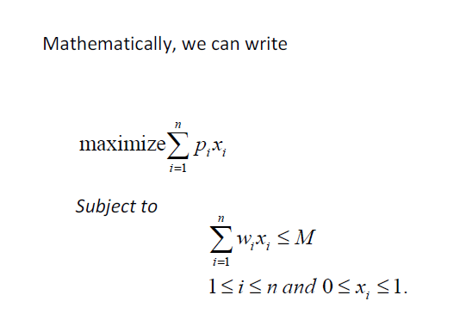
Fractional Knapsack Problem
Let there are n number of objects and each object is having a weight and contribution to profit. The knapsack of capacity M is given. The objective is to fill the knapsack in such a way that profit shall be maximum. We allow a fraction of item to be added to the knapsack.
Where pi and wi are the profit and weight of ith object and xi is the fraction of ith object to be selected.
For example
Given n = 3, (p1, p2, p3) = {25, 24, 15}
( w1, w2, w3) = {18, 15, 10} M = 20

Slide 59
Algorithm KNAPSACK
AlgorithmFKNAPSACK (p, w, x, n, M) // p[1:n] and w[1:n] contains the profit and weight of n objects. Mis the maximum capacity of knapsack and x[1:n] in the solution vector.//
{
for (i = 1; i<= n; i ++)
x[i] = 0 ; // initialize the solution to 0 //
cu = M // cu is the remaining capacity of the knapsack//
for (i =1; i<= n ; i ++){
if(w[i] >cu )
break;
else{
x[i] = 1 ;
cu = cu – w[i] ;
}
}
if( i<= n){
x[i] = cu/w[i] ;
returnx;
}

Slide 60
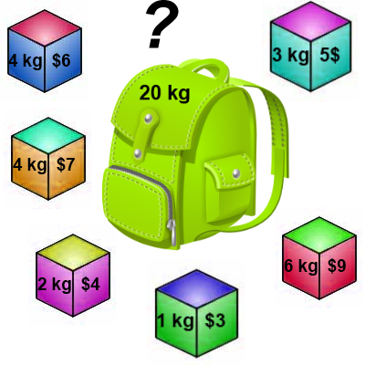
Knapsack 0-1 Problem
The goal is to maximize the value of a knapsack that can hold at most W units (kg) worth of goods from a list of items I₀, I₁, … I_{n-1}.
Each item has 2 attributes:
Value – let this be v_{i} for item I_{i}
Weight – let this be w_{i} for item I_{i}

Slide 61
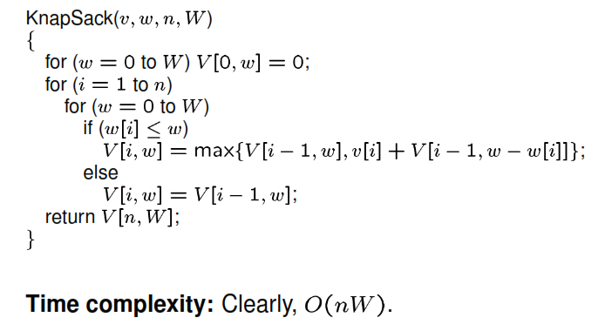

Slide 62
0-1 Knapsack problem: brute-force approach
Let’s first solve this problem with a straightforward algorithm
Since there are n items, there are 2^{n} possible combinations of items.
We go through all combinations and find the one with the most total value and with total weight less or equal to W.
Running time will be O(2^{n}).

Slide 63
The Traveling Salesman Problem
The traveling salesman problem consists of a salesman and a set of cities.
The salesman has to visit each one of the cities starting from a certain one (e.g. the hometown) and returning to the same city.
The challenge of the problem is that the traveling salesman wants to minimize the total length of the trip.
The traveling salesman problem can be described as follows:
TSP = {(G, f, t): G = (V, E) a complète graph, f is a function V×V Z, →
t ∈ Z, G is a graph that contains a traveling salesman tour with cost that does not exceed t}.

Slide 64
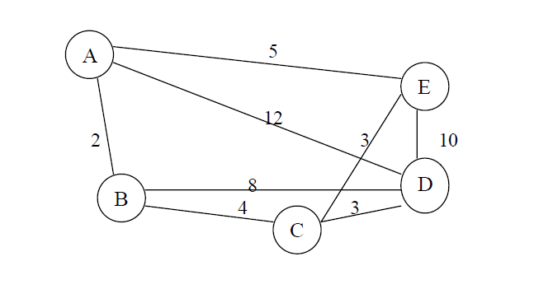
Example:
Consider the following set of cities:
A graph with weights on its edges. The problem lies in finding a minimal path passing from all vertices once. For example the path
Path1 {A, B, C, D, E, A} and the path Path2 {A, B, C, E, D, A} pass all the vertices but Path1 has a total length of 24 and Path2 has a total length of 31.

Slide 65


